Slide 1
POC Security testing tool – OWASP ZAP

Slide 2
Table of Contents
Overview
How does ZAP Work?
ZAP Installation
ZAP Desktop UI
Running an Automated Scan
Key Findings
View Alerts and Alert Details
RIL Scan Report

Slide 3
Overview
Zed Attack Proxy (ZAP) is a free, open-source penetration testing tool being maintained under the umbrella of the Open Web Application Security Project (OWASP). ZAP is designed specifically for testing web applications and is both flexible and extensible.
ZAP is what is known as a “man-in-the-middle proxy.” It stands between the tester’s browser and the web application so that it can intercept and inspect messages sent between browser and web application, modify the contents if needed, and then forward those packets on to the destination. It can be used as a stand-alone application, and as a daemon process.

Slide 4
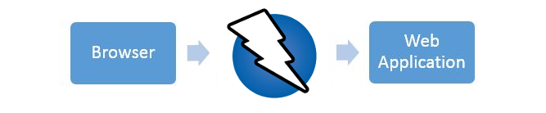
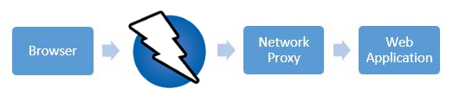
OWASP ZAP Overview
If there is another network proxy already in use, as in many corporate environments, ZAP can be configured to connect to that proxy.

Slide 5
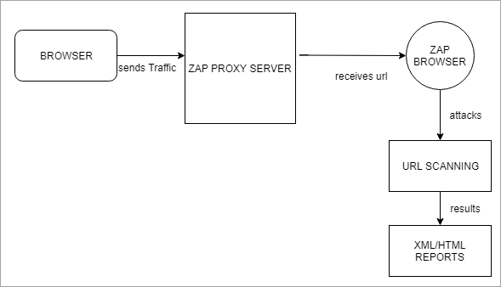
How does ZAP Work?
ZAP creates a proxy server and makes the website traffic pass through the server
Refer to this flow chart for a better understanding:

Slide 6
ZAP Installation
ZAP has installers for Windows, Linux, and Mac OS/X.
Install ZAP
The first thing to do is install ZAP on the system you intend to perform pentesting on. Download the appropriate installer from the Download page.
Note that ZAP requires Java 8+ in order to run. The Mac OS/X installer includes an appropriate version of Java but you must install Java 8+ separately for Windows, Linux, and Cross-Platform versions.
Once the installation is complete, launch ZAP and read the license terms. Click Agree if you accept the terms, and ZAP will finish installing, then ZAP will automatically start.

Slide 7
ZAP Desktop UI
The ZAP Desktop UI is composed of the following elements:
Menu Bar – Provides access to many of the automated and manual tools.
Toolbar – Includes buttons which provide easy access to most commonly used features.
Tree Window – Displays the Sites tree and the Scripts tree.
Workspace Window – Displays requests, responses, and scripts and allows you to edit them.
Information Window – Displays details of the automated and manual tools.
Footer – Displays a summary of the alerts found and the status of the main automated tools.

Slide 8
ZAP Desktop UI

Slide 9
Running an Automated Scan
The easiest way to start using ZAP is via the Quick Start tab. Quick Start is a ZAP add-on that is included automatically when you installed ZAP.
To run a Quick Start Automated Scan :
1.Start ZAP and click the Quick Start tab of the Workspace Window.
2.Click the large Automated Scan button.
3.In the URL to attack text box, enter the full URL of the web application you want to attack.
4.Click the Attack tools.

Slide 10
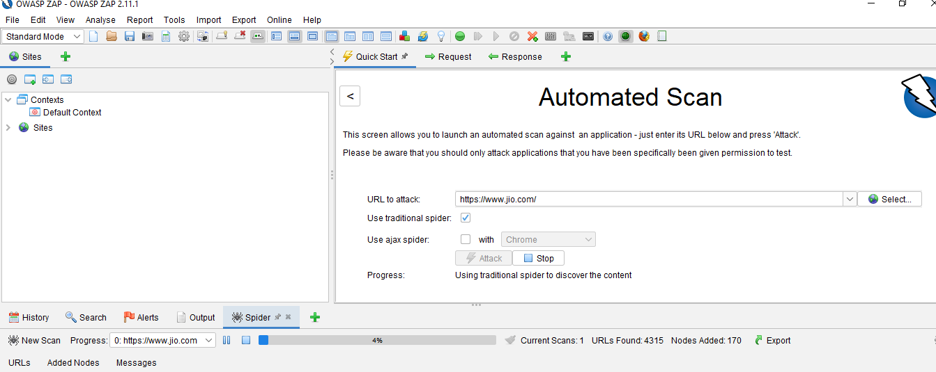
Running an Automated Scan

Slide 11
Key Findings
ZAP will crawl the web application with its spider and passively scan each page it finds. Then ZAP will use the active scanner to attack all of the discovered pages, functionality, and parameters.
ZAP provides 2 spiders for crawling web applications, we can use either or both of them from this screen.
The traditional ZAP spider which discovers links by examining the HTML in responses from the web application. This spider is fast, but it is not always effective when exploring an AJAX web application that generates links using JavaScript.
For AJAX applications, ZAP’s AJAX spider is likely to be more effective. This spider explores the web application by invoking browsers which then follow the links that have been generated. The AJAX spider is slower than the traditional spider and requires additional configuration for use in a “headless” environment.
ZAP will passively scan all of the requests and responses proxied through it. Passive scanning is good at finding some vulnerabilities and as a way to get a feel for the basic security state of a web application and locate where more investigation may be warranted.
Active scanning, however, attempts to find other vulnerabilities by using known attacks against the selected targets. Active scanning is a real attack on those targets and can put the targets at risk, so do not use active scanning against targets you do not have permission to test.

Slide 12
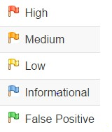
View Alerts and Alert Details
The left-hand side of the Footer contains a count of the Alerts found during your test, broken out into risk categories. These risk categories are:
To view the alerts created during your test:
Click the Alerts tab in the Information Window.
Click each alert displayed in that window to display the URL and the vulnerability detected in the right side of the Information Window.
In the Workspace Windows, click the Response tab to see the contents of the header and body of the response. The part of the response that generated the alert will be highlighted.

Slide 13


